Slide 1
The NEOS Benchmarking Service
Robert Fourer
Industrial Engineering & Management Sciences
Northwestern University
4er@iems.northwestern.edu
Liz Dolan, Jorge Moré, Todd Munson
Mathematics & Computer Science Division
Argonne National Laboratory
[more,tmunson]@mcs.anl.gov
INFORMS International
Session MC07, July 9, 2007

Slide 2
The NEOS Benchmarking Service
One of the “solvers” on NEOS 5 is actually a benchmarking service that runs a submitted problem on a selection of solvers on the same machine. In addition to output listings from the solvers, the service optionally returns an independent assessment of the quality of the results. It is particularly useful in choosing a solver for a particular application.

Slide 3
Benchmarking
Fundamentals
  Collection of test problems
  Collection of solvers & solver parameter settings
Performance measures
  Number of iterations
  Number of function evaluations
  Number of conjugate gradient iterations
  Computing time
Issues
  Running the solvers
  Verifying the results
  Comparing performance

Slide 4
Running Solvers
Benchmarking
NEOS benchmarking tools
  User submits one problem to NEOS benchmark “solver”
  User selects solvers to be compared
  NEOS tries all solvers, using the same computer
  NEOS verifies reported solutions
  NEOS returns listing of results
Other current benchmarking resources
  Hans Mittelmann’s benchmark pages, plato.la.asu.edu/bench.html
  PAVER performance analysis tool,
  www.gamsworld.org/performance/paver/
. . . access to numerous solvers is essential

Slide 5
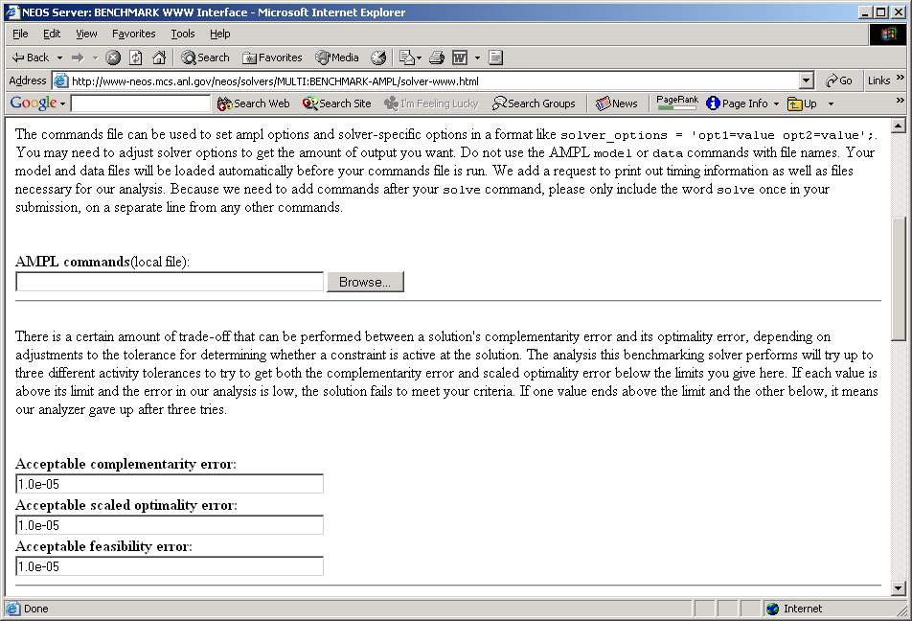
NEOS Tools
Benchmarking
Benchmarking web page (instructions)

Slide 6
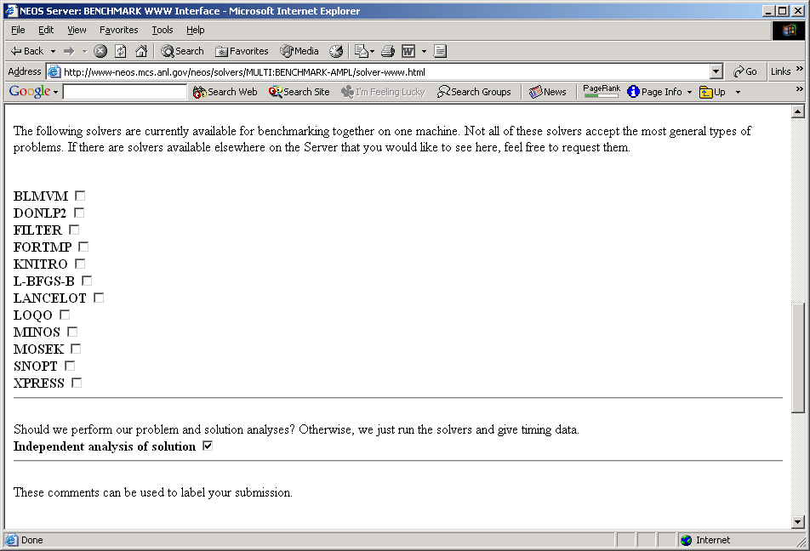
NEOS Tools (cont’d)
Benchmarking
Benchmarking web page (solver choice)

Slide 7
Verifying Results
Benchmarking
Comparable running environments
  Same computer and operating system
  User’s choice of solver parameters
  User’s choice of tolerances for
  feasibility, optimality, complementarity
Independent assessment of solutions
  Based only on solution returned
  E.D. Dolan, J.J. Moré and T.S. Munson,
  “Optimality Measures for Performance Profiles”
  (available from www.optimization-online.org)

Slide 8
NEOS Tools (cont’d)
Benchmarking
Benchmark verification results
Solver lbfgsb.
feasibility error 0.000000e+00
complementarity error 0.000000e+00
optimality error 1.923416e-07
scaled optimality error 3.827304e-06
Solver solution optimality and complementarity found acceptable.
Solver loqo.
feasibility error 0.000000e+00
complementarity error 7.554012e-05
optimality error 6.588373e-06
scaled optimality error 1.311233e-04
Solver solution not acceptable by this analysis because the scaled optimality error is greater than your limit of 1.0e-05 and the complementarity error is greater than your limit of 1.0e-05.

Slide 9
Comparing Performance
Benchmarking
Average or cumulative totals of metric
  Sensitive to results on a small number of problems
Medians or quartiles of a metric
  Information between quartiles is lost
Number of k-th place entries
  No information on the size of improvement
Number of wins by a fixed amount or percentage
  Dependent on the subjective choice of a parameter

Slide 10
Performance Profiles
Benchmarking
Quantities to compute
  For each solver s on each test problem p:
  ratio r_{ps} of that solver’s metric to best solver’s metric
  For each solver s:
  fraction ρ_{s}(τ) of test problems that have log₂ r_{ps} ≤ τ
Values to display
  Plot ρ_{s}(τ) vs. τ for each solver s
  ρ_{s} : ℜ → [0,1] is a non-decreasing, piecewise constant function
  ρ_{s}(0) is the fraction of problems on which solver s was best
  ρ_{s}(∞) is the fraction of problems on which solver s did not fail
  Emphasis goes from performance to reliability
  as you go from left to right in the plot
E.D. Dolan and J.J. Moré,
“Benchmarking Optimization Software with Performance Profiles.”
Mathematical Programming 91 (2002) 201–213.

Slide 11
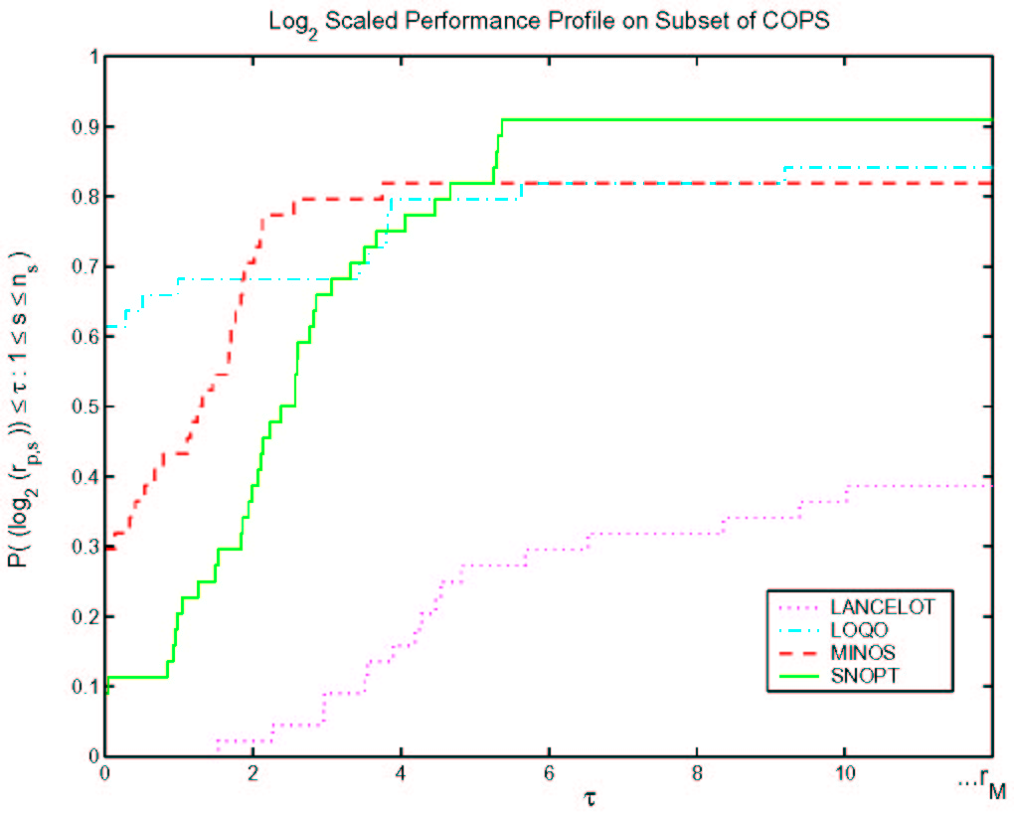
Performance Profiles (cont’d)
Benchmarking
COPS optimal control problems

Slide 12
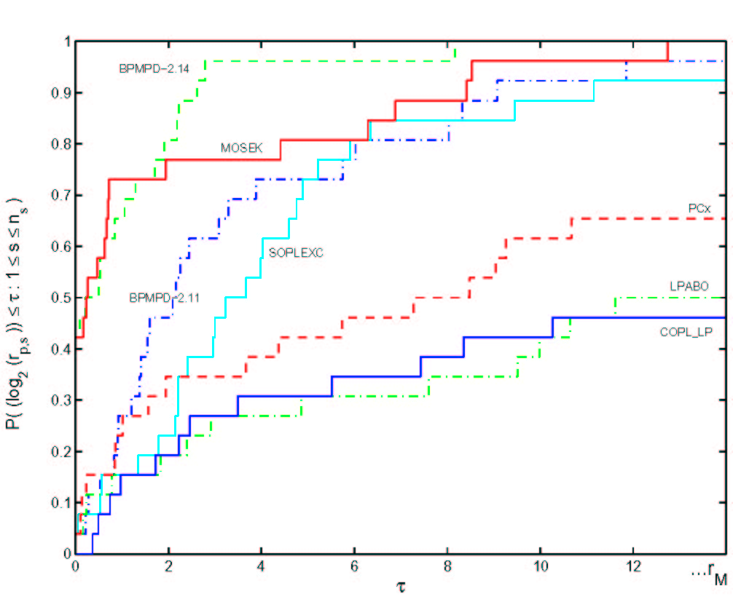
Performance Profiles (cont’d)
Benchmarking
Mittelman test problems

Slide 13
Performance Profiles (cont’d)
Benchmarking
Advantages
  Not sensitive to the data on a small number of problems
  Not sensitive to small changes in the data
  Information on the size of improvement is provided
  Does not depend on the subjective choice of a parameter
  Can be used to compare more than two solvers
Further research interests
  Multi-problem NEOS benchmarking tool
  Automated benchmark runs
  Automated generation of result tables & performance profiles

Slide 14
Automated Benchmarking
Forthcoming
NEOS benchmarker
  User submits one problem to NEOS benchmark “solver”
  User selects solvers to be compared
  NEOS tries all solvers, using the same computer
  NEOS verifies reported solutions
  NEOS returns listing of results
Other current benchmarking resources
  Hans Mittelmann’s benchmark pages, plato.la.asu.edu/bench.html
  PAVER performance analysis tool,
  www.gamsworld.org/performance/paver/
. . . access to numerous solvers is essential

Slide 15
Benchmarking (cont’d)
Forthcoming
NEOS benchmarking web page (instructions)

Slide 16
Benchmarking (cont’d)
Forthcoming
NEOS benchmarking web page (solver choice)

Slide 17
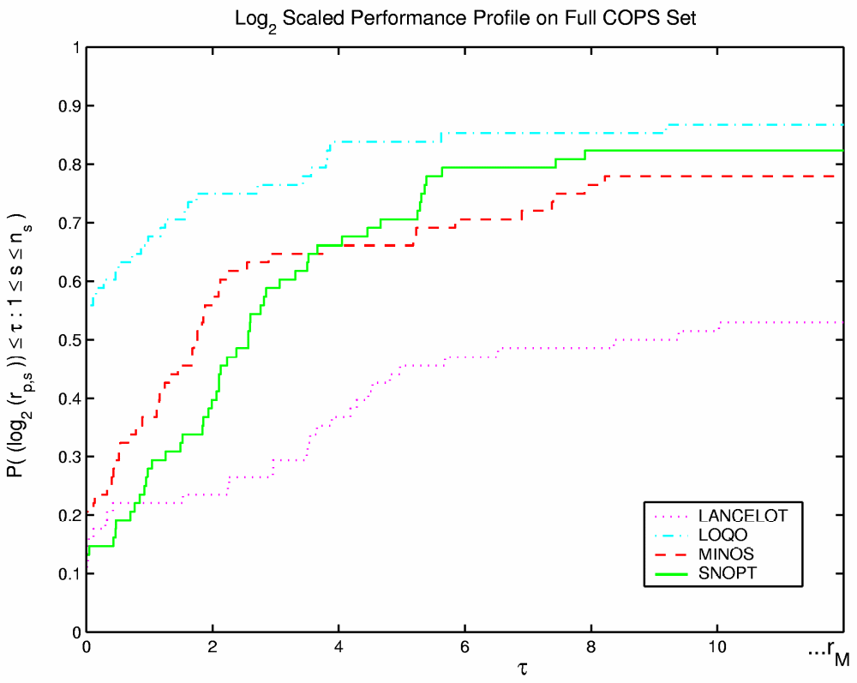
Benchmarking (cont’d)
Forthcoming
Features to come
  Run specified set of test problems
  Make fair option choices for each solver
  Produce performance profiles . . .

Slide 18
Benchmarking Interface
Using NEOS
Benchmarking web page (instructions)

Slide 19
Benchmarking Interface (cont’d)
Web page (solver choice)

Slide 20
Verifying Results
Benchmarking
Comparable running environments
  Same computer and operating system
  User’s choice of solver parameters
  User’s choice of tolerances for
  feasibility, optimality, complementarity
Independent assessment of solutions
  Based only on solution returned
  E.D. Dolan, J.J. Moré and T.S. Munson,
  “Optimality Measures for Performance Profiles”
  (available from www.optimization-online.org)

Slide 21
Verifying Results (cont’d)
Benchmarking
Benchmark verification results
Solver lbfgsb.
feasibility error 0.000000e+00
complementarity error 0.000000e+00
optimality error 1.923416e-07
scaled optimality error 3.827304e-06
Solver solution optimality and complementarity found acceptable.
Solver loqo.
feasibility error 0.000000e+00
complementarity error 7.554012e-05
optimality error 6.588373e-06
scaled optimality error 1.311233e-04
Solver solution not acceptable by this analysis because the scaled optimality error is greater than your limit of 1.0e-05 and the complementarity error is greater than your limit of 1.0e-05.

